Slide 1
Dashboard Design Task 4
Ashritha Anandal
Tool: PowerBI
Dataset: Superstore

Slide 2
Objective
Analyze overall sales and profit performance.
Identify top performing regions and product categories.
Track sales trends over time.
Provide insights to support business decisions.
Create an interactive dashboard for stakeholders.

Slide 3
Key Performance Indicators (KPIs)
Total Sales: 2.30 Million
Total Profit: 286 Thousand
Total Quantity Sold: 38 Thousand units
Profit Margin: 12%
Observation:
The company is profitable overall.
Profit margin shows moderate performance.

Slide 4
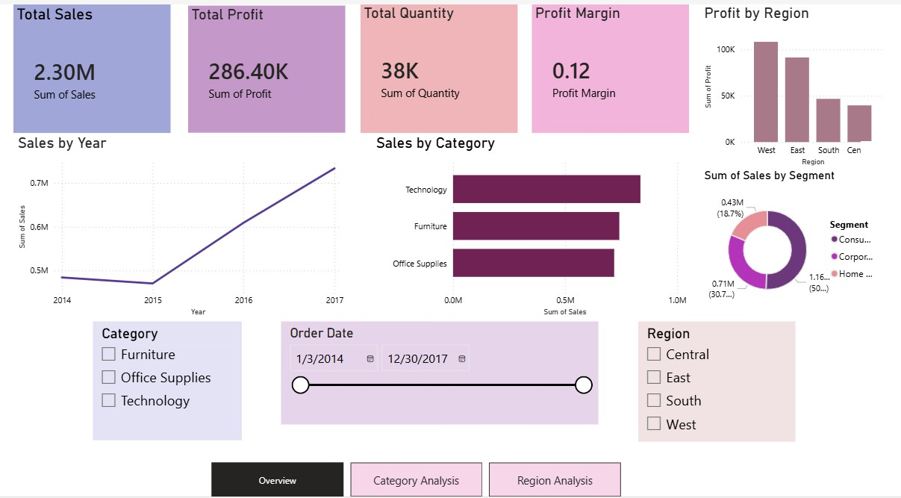
Dashboard Overview
Includes:
KPI summary cards
Sales trend over time
Sales by category
Profit by region
Sales by customer segment
Interactive filters (slicers)
Navigation between pages

Slide 5
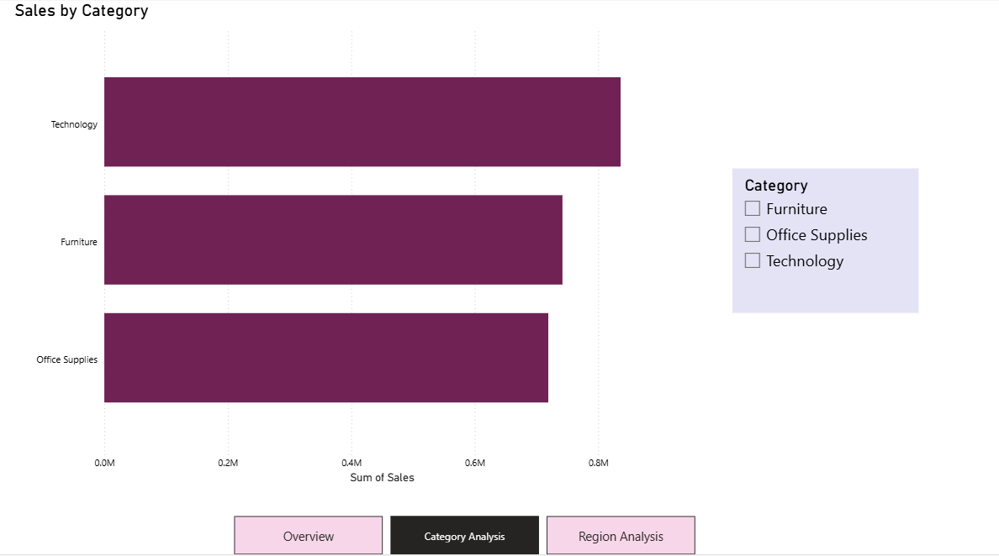
By Category

Slide 6
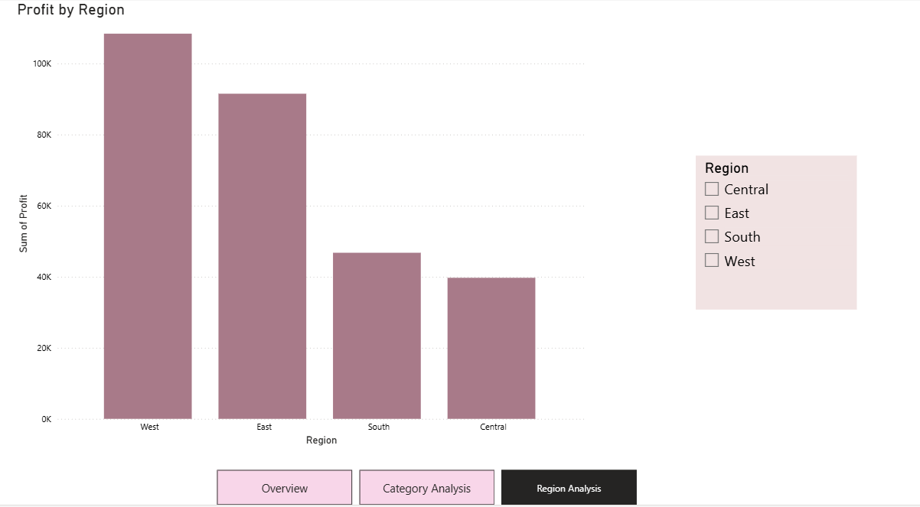
By Region

Slide 7
Insights
West region generates the highest profit.
Sales show a steady increase from 2015 to 2017.
Technology category has the highest sales.
Consumer segment contributes the largest share of sales.

Slide 8
Business Recommendations
Focus marketing on high-performing regions like West.
Invest more in Technology products.
Improve performance in low-profit regions.
Target the Consumer segment for growth.

